Slide 1
Unsupervised learning

Slide 2
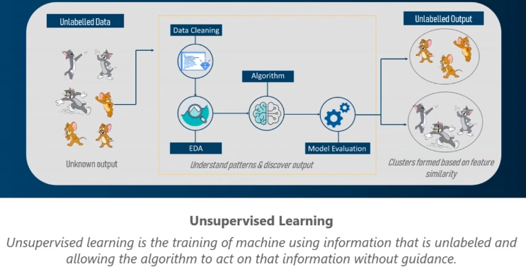

Slide 3
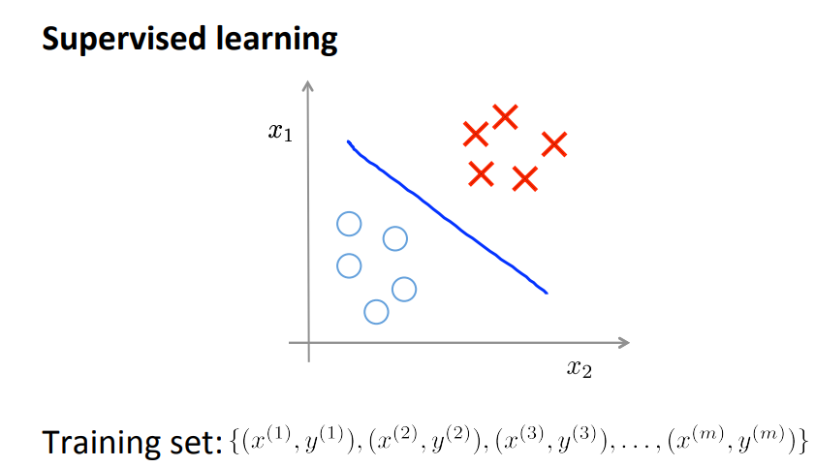
Supervised learning

Slide 4
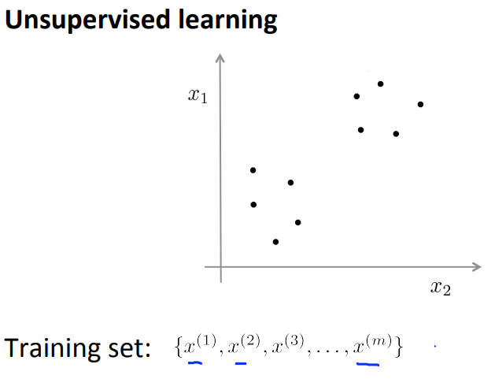
Unsupervised learning
Given some example without labels, do something!

Slide 5
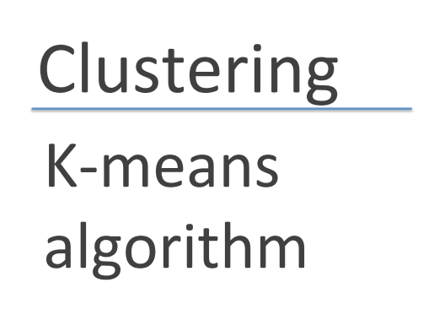
Unsupervised learning

Slide 6
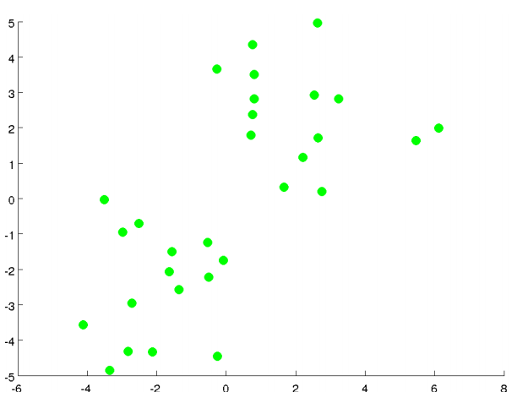
Unsupervised learning

Slide 7
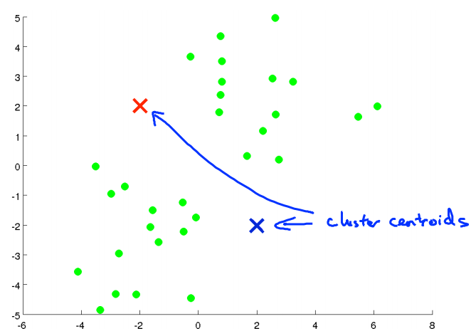
Unsupervised learning

Slide 8
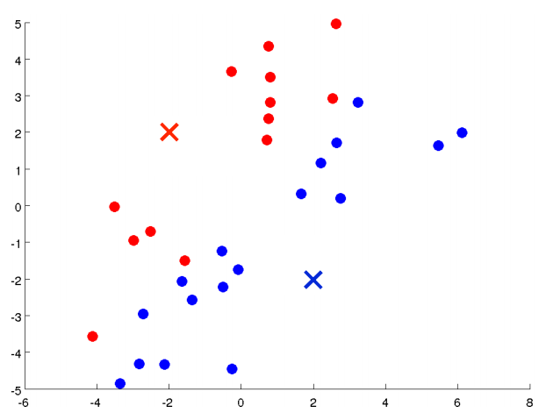
Unsupervised learning

Slide 9
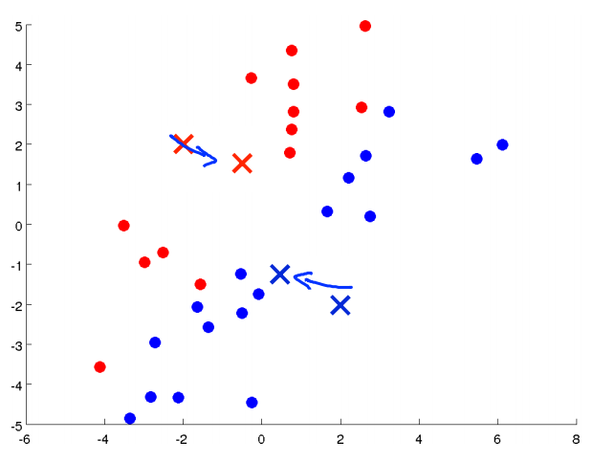
Unsupervised learning

Slide 10
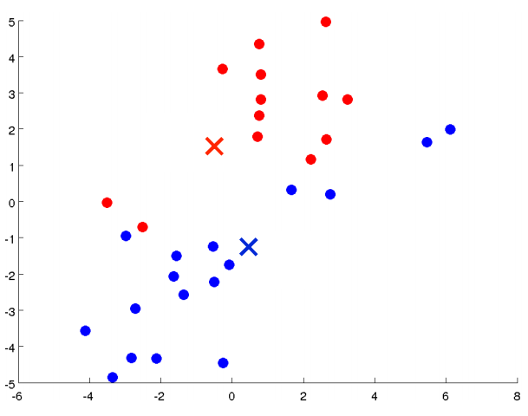
Unsupervised learning

Slide 11
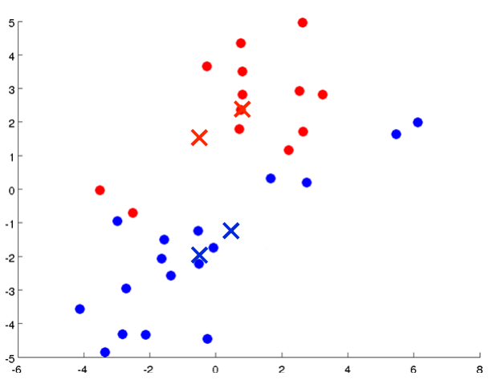
Unsupervised learning

Slide 12
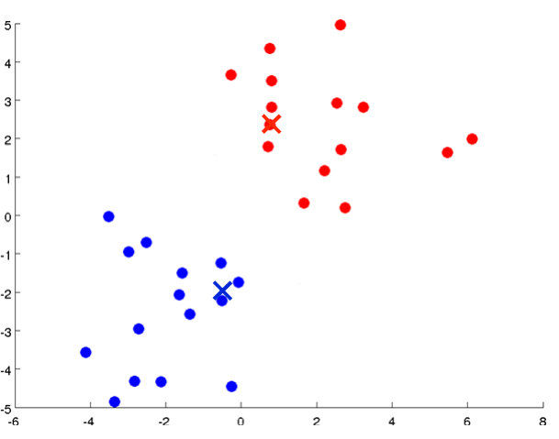
Unsupervised learning

Slide 13
Unsupervised learning

Slide 14
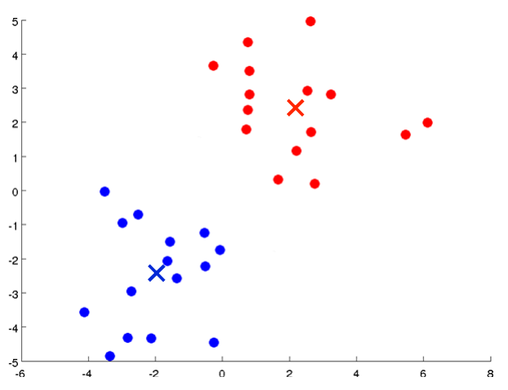
Unsupervised learning

Slide 15
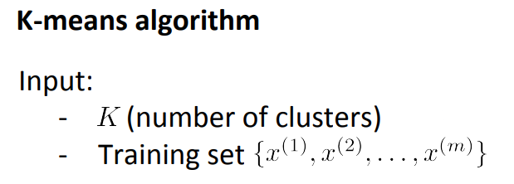
Unsupervised learning

Slide 16
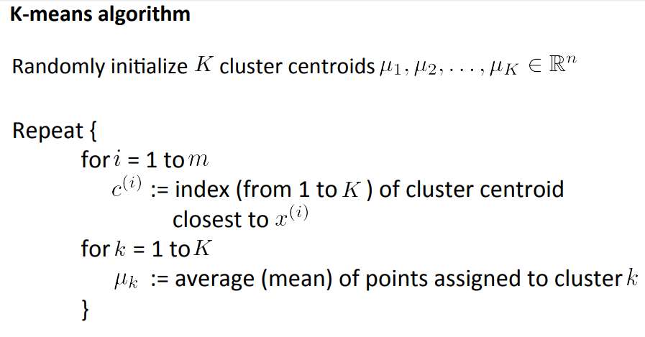
Unsupervised learning

Slide 17
Unsupervised learning
Given some example without labels, do something!

Slide 18
Unsupervised learning: clustering
Raw data
Features
f₁, f₂, f₃, …, f_{n}
f₁, f₂, f₃, …, f_{n}
Clusters
f₁, f₂, f₃, …, f_{n}
f₁, f₂, f₃, …, f_{n}
group into classes/clusters
extract
features
f₁, f₂, f₃, …, f_{n}
No “supervision”, we’re only given data and want to find natural groupings

Slide 19
Unsupervised learning: modeling
Most frequently, when people think of unsupervised learning they think clustering
Clustering: the process of grouping a set of objects into classes of similar objects

Slide 20
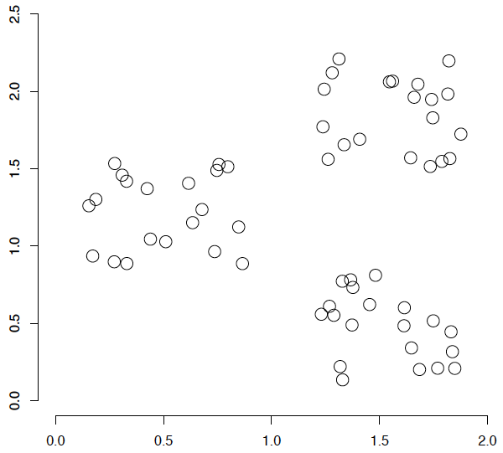
A data set with clear cluster structure

Slide 21
Issues for clustering
Representation for clustering
How do we represent an example
features, etc.
Similarity/distance between examples

Slide 22
Hard vs. soft clustering
Hard clustering: Each example belongs to exactly one cluster
Soft clustering: An example can belong to more than one cluster (probabilistic)

Slide 23
K-means
Most well-known and popular clustering algorithm:
Start with some initial cluster centers
Iterate:
Assign/cluster each example to closest center
Recalculate centers as the mean of the points in a cluster

Slide 24
K-means: an example

Slide 25
K-means: Initialize centers randomly

Slide 26
K-means: assign points to nearest center

Slide 27
K-means: readjust centers

Slide 28
K-means: assign points to nearest center

Slide 29
K-means: readjust centers

Slide 30
K-means: assign points to nearest center

Slide 31
K-means: readjust centers

Slide 32
K-means: assign points to nearest center
No changes: Done

Slide 33
K-means
Iterate:
Assign/cluster each example to closest center
Recalculate centers as the mean of the points in a cluster
How do we do this?

Slide 34
K-means
Iterate:
Assign/cluster each example to closest center
Recalculate centers as the mean of the points in a cluster
iterate over each point:
- get distance to each cluster center
- assign to closest center (hard cluster)

Slide 35
K-means
Iterate:
Assign/cluster each example to closest center
Recalculate centers as the mean of the points in a cluster
iterate over each point:
- get distance to each cluster center
- assign to closest center (hard cluster)
What distance measure should we use?

Slide 36
Distance measures
Euclidean:
good for spatial data

